Slide 1
Middleware and handoff to human

Slide 2
Intercepting messages
Middleware
Capture incoming and outgoing messages
Usage
Logging
Troubleshooting

Slide 3
Privacy concerns
Bot Framework does not store messages
State (UserData, ConversationData, DialogData) is stored
Provide details to your users about what is stored
If you will be logging messages for learning purposes, ensure you let your users know
Chat with your legal department

Slide 4
Middleware

Slide 5
Handoff to Human
Every company deals with this:
First triage/data collection
Simple and repetitive solutions
Customer call
Complex cases and escalation

Slide 6
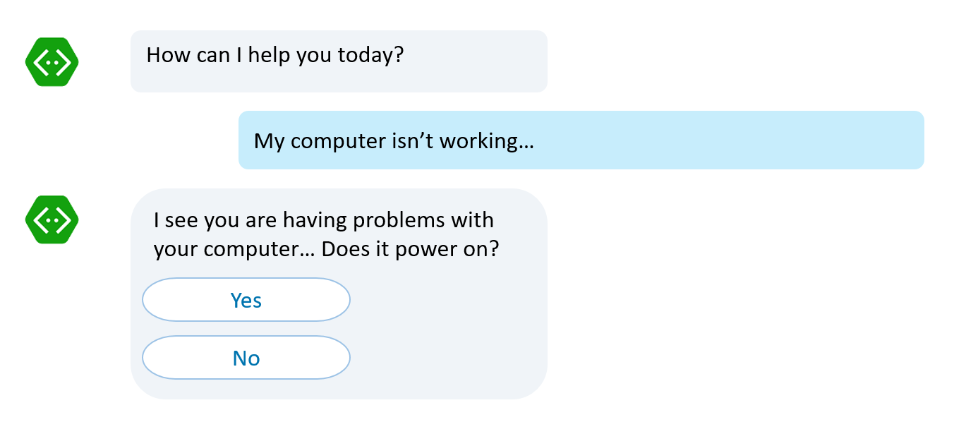
Handoff to Human
First triage/data collection
Simple and repetitive solutions
Customer call
No waiting in line to be helped Bots handle it
Complex cases and escalation

Slide 7
Handoff to Human
If it is simple and repetitive, it can be coded. Bots can accelerate it
First triage/data collection
Simple and repetitive solutions
Customer call
Complex cases and escalation

Slide 8
Handoff to Human
Bot to human hand off: Complete or supervised
Complex cases and escalation

Slide 9

Handoff to Human
Complete bot to human hand off
Thank you for providing all this information. I have John with me now who will take from here and help you out
Hello, this is John. I understand your computer won’t power on. Let’s take a look at some service options

Slide 10
Handoff to Human
Supervised bot to human hand off
I’ve tried these steps, my computer still won’t turn on
Note to operator: It sounds like the user will need hardware replacement, what next step should I take?
Apologize to user
Suggest hardware service
Let me type
I suggest us to request a hardware service. We can have one of our service engineers look at your computer
Sounds lovely, thank you

Slide 11
Handoff to Human
https://docs.microsoft.com/en-us/bot-framework/bot-design-pattern-handoff-human

Slide 12
Anatomy of a handoff

Slide 13
Customers
Agents

Slide 14
Customers
Agents

Slide 15
Customers
Agents

Slide 16
Customers
Agents

Slide 17
Customers
Agents

Slide 18
Agent Recognition
const isAgent = (session: BotBuilder.Session) => boolean;
Possible implementations
Username + Channel (“palindromed on Skype”);
Auth tokens via Direct Line backchannel
In this sample: username begins with “Agent”

Slide 19
Customers
Agents

Slide 20
Customers
Router
Agents

Slide 21
Customers
Router
Conversational
Metadata
Agents

Slide 22
Metadata
Conversation
Customer address
Agent address
Transcript
State
Bot
Waiting
Agent
Watch

Slide 23
State 1: Bot
switch (conversation.state) {
case ConversationState.Bot:
next();
}

Slide 24
Customers
Router
Conversational
Metadata
Agents

Slide 25
Customers
Router
Conversational
Metadata
Agents

Slide 26
Customers
Router
Conversational
Metadata
Agents

Slide 27
Customers
Router
Conversational
Metadata
Agents

Slide 28
Customers
Router
Conversational
Metadata
Agents

Slide 29
Customers
Router
Conversational
Metadata
Agents

Slide 30

How do we change state?

Slide 31
Handoff triggers
Customer bot logic
Intent/Command (“connect to agent”)
Text analytics (“This is getting really annoying”)
Default response has been sent too many times
Call center UX (button)
In this sample: Middleware to handle commands

Slide 32
State 2: Waiting
switch (conversation.state) {
case ConversationState.Waiting:
session.send(
"Connecting you to the next available agent.");
return;
}

Slide 33
Customers
“help”
Commands
Router
Conversational
Metadata
Agents

Slide 34
Customers
State: Waiting
Commands
Router
Conversational
Metadata
Agents

Slide 35
Customers
Commands
Router
Conversational
Metadata
Agents

Slide 36
State 3: Agent
switch (conversation.state) {
case ConversationState.Agent:
bot.send(
new builder.Message()
.address(conversation.agent)
.text(message.text));
return;
}

Slide 37
Customers
Commands
Router
Conversational
Metadata
Agents
“waiting”

Slide 38
Customers
State: Agent
Commands
Router
Conversational
Metadata
Agents

Slide 39
Customers
Commands
Router
Conversational
Metadata
Agents

Slide 40
Customers
Commands
Router
Conversational
Metadata
Agents

Slide 41
Customers
Commands
Router
Conversational
Metadata
Agents

Slide 42
Customers
Commands
Router
Conversational
Metadata
Agents

Slide 43
Customers
Commands
Router
Conversational
Metadata
Agents

Slide 44
Customers
Commands
Router
Conversational
Metadata
Agents

Slide 45
Customers
Commands
Router
Conversational
Metadata
Agents

Slide 46
Customers
Commands
Router
Conversational
Metadata
Agents

Slide 47
State 4: Watch
switch (conversation.state) {
case ConversationState.Watch:
bot.send(
new builder.Message()
.address(conversation.agent)
.text(message.text));
next();

Slide 48
Customers
Commands
Router
Conversational
Metadata
Agents
“watch customer”

Slide 49
State: Watch
Customers
Commands
Router
Conversational
Metadata
Agents

Slide 50
Customers
Commands
Router
Conversational
Metadata
Agents

Slide 51
Customers
Commands
Router
Conversational
Metadata
Agents

Slide 52
Customers
Commands
Router
Conversational
Metadata
Agents

Slide 53
Customers
Commands
Router
Conversational
Metadata
Agents

Slide 54
Handoff in action

Slide 55
Your turn
Update your bot to:
Allow users to communicate with help desk personnel

